Slide 1

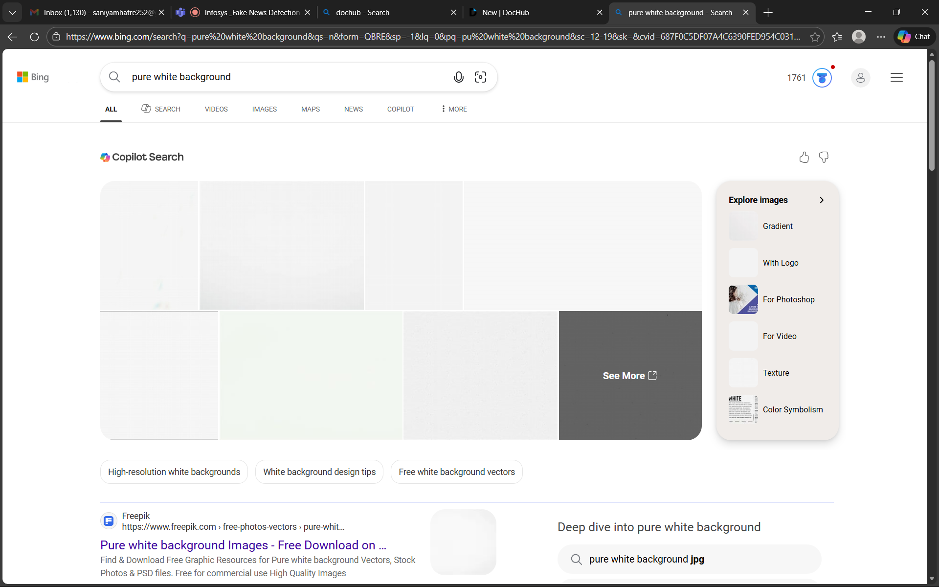
Fake News Detection & Verification Tool
In an age of information overload, discerning truth from falsehood has become a critical challenge. Our tool is designed to empower you with the ability to identify and combat fake news effectively.

Slide 2

Project Statement: Combating Misinformation with Intelligent Verification
Our project aims to develop an advanced Fake News Detection & Verification Tool that leverages cutting-edge technologies like Artificial Intelligence (AI) and Natural Language Processing (NLP). We are committed to building a robust, accurate, and user-friendly platform that helps individuals and organisations navigate the complex landscape of digital information.

Slide 3




Expected Outcomes: A Reliable, User-Friendly Tool for Identifying Fake News
Enhanced Accuracy
Intuitive Experience
Significantly improve the precision of fake news identification, reducing false positives and negatives.
Deliver a simple, easy-to-use interface that makes verification accessible to everyone.
Real-time Verification
Increased Trust
Provide quick and efficient analysis, enabling users to verify information as it emerges.
Foster a more informed online environment by helping users make well-grounded decisions.

Slide 4
Key Modules: How Our Tool Will Work
Our Fake News Detection and Verification Tool is built upon a foundation of interconnected modules, each playing a crucial role in the overall process of identifying and assessing misinformation.
01
02
03
Data Ingestion & Pre-processing
Feature Extraction
Detection Engine
Collecting and cleaning news articles from various sources.
Identifying key linguistic and metadata features for analysis.
Utilising AI/ML models to flag potential fake news.
04
05
Verification Engine
User Interface
Cross-referencing flagged articles with reliable sources.
Providing a seamless experience for submitting and viewing results.

Slide 5

System Architecture: A Simplified View of Our Tool's Inner Workings
The architecture diagram illustrates the flow of data and interaction between different components of our tool, ensuring efficient and accurate fake news detection and verification.
Database
Data Ingestion
Store records and metadata
Collect content from sources
Verification Engine
System Architecture
Pre-processing
Cross-check facts and sources
Clean and normalize data
AI/ML Detection Engine
Feature Extraction
Identify potential misinformation
Derive signals and features

Slide 6
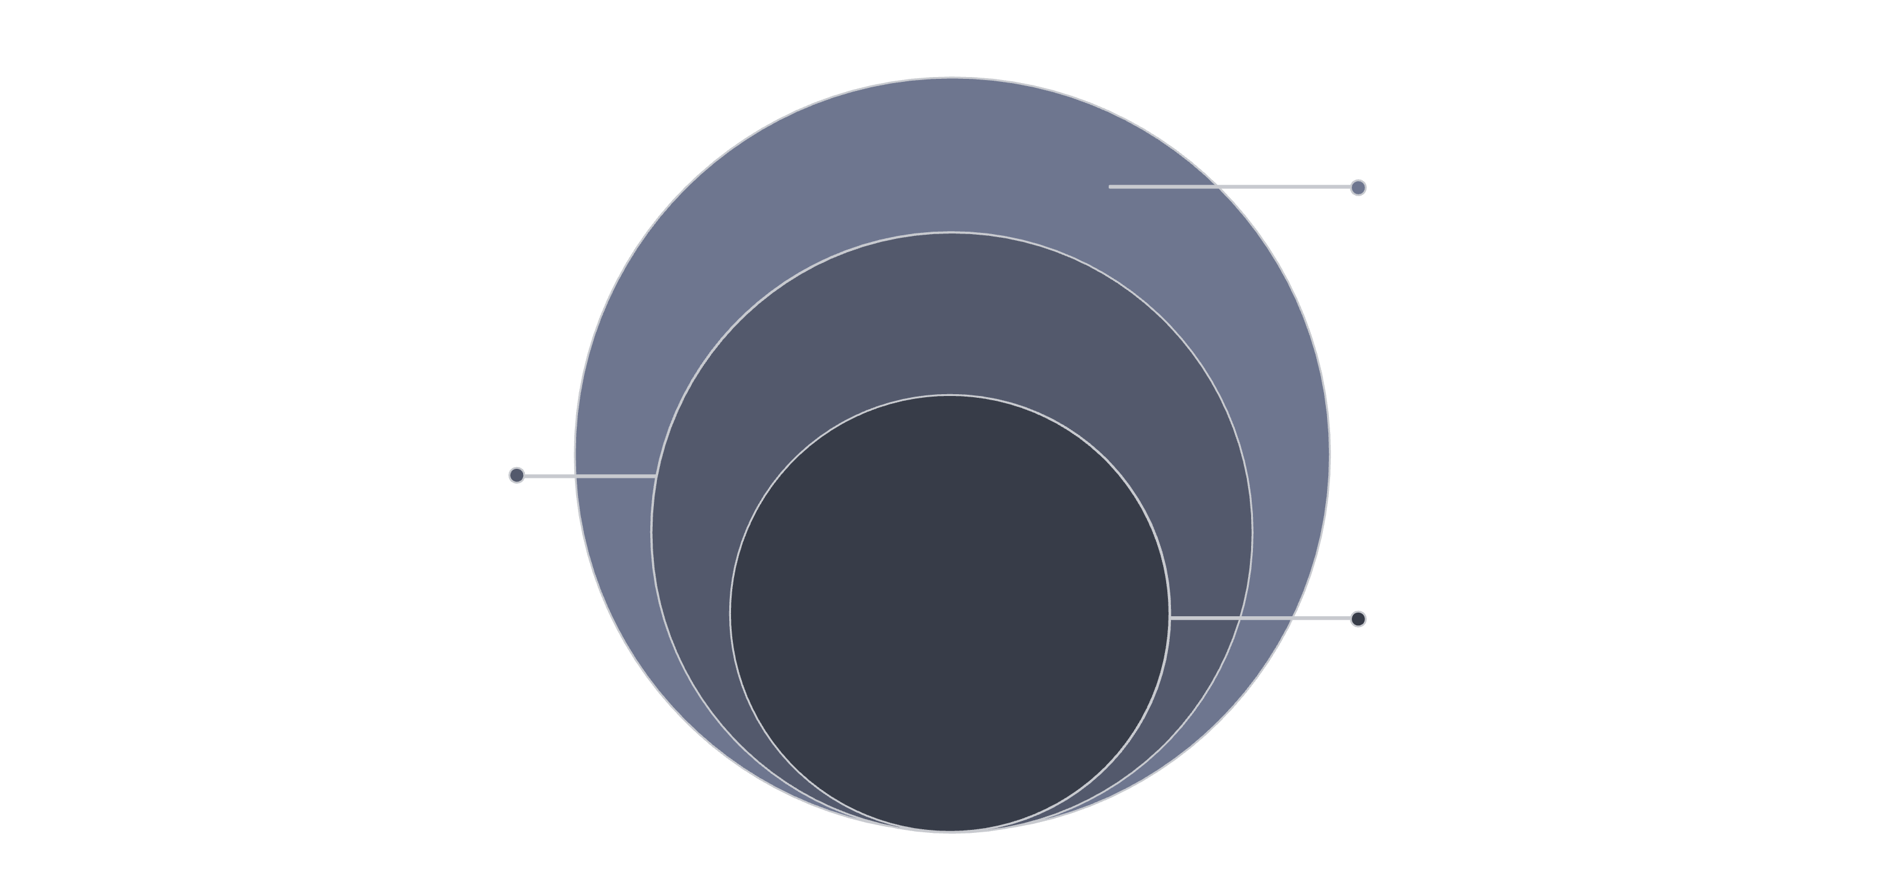
Database Schema: How We Store and Manage Our Data
Our database schema is meticulously designed to efficiently store and retrieve all necessary information, from news article content to verification results and user feedback. This structured approach ensures data integrity and supports robust analysis.
Supporting Entities
Sources (SourceID, Name, Reliability) and Users (UserID, Username, Role)
Verification Layer
ResultID, ArticleID, Status, ConfidenceScore, VerifiedBy
Core: Articles
ArticleID, Title, Content, Source, PublicationDate

Slide 7












Detection Techniques: AI, NLP, and More Working Together
We employ a multi-faceted approach to detect fake news, combining the power of Artificial Intelligence (AI), Natural Language Processing (NLP), and advanced statistical analysis to identify suspicious patterns and anomalies.
AI & Machine Learning
Natural Language Processing
Utilising algorithms like SVM, Random Forest, and deep learning for classification.
Analysing text for sentiment, readability, stylistic inconsistencies, and linguistic cues.
Statistical Anomaly Detection
Fact-Checking
Cross-referencing claims against established reputable sources and databases.
Spotting unusual publication frequencies, engagement rates, and other data outliers.
Multimedia Analysis
Social Network Analysis
Detecting manipulated images and videos to expose visual falsehoods.
Identifying propagation patterns and influential spreaders of misinformation.

Slide 8

Verification Process: Steps to Confirm News Authenticity
Once an article is flagged, our verification engine initiates a rigorous process to confirm its authenticity, ensuring that only thoroughly vetted information is presented to the user.
Source Credibility Check
Evaluating the reputation and historical accuracy of the news source.
Content Analysis
Examining factual claims, logical consistency, and emotional language.
Contextualisation
Understanding the broader narrative and potential biases surrounding the information.
Expert Review (Optional)
Engaging human fact-checkers for complex or highly sensitive cases.
Verdict & Reporting
Assigning a verification status and providing a clear explanation to the user.

Slide 9

Demo/Use Case: See Our Tool in Action!
Imagine a user encountering a suspicious news headline on their feed. With our tool, they can simply copy and paste the article link or text, and receive an instant assessment of its authenticity, complete with a detailed breakdown of the verification process.
Scenario:
User sees a viral article about a new 'miracle cure'.
User inputs the article into our tool.
Our tool analyses the content, source, and claims.
The tool provides a "False" rating with reasons, such as unverified claims and unreliable sources.
User can confidently dismiss the misinformation.

Slide 10


Conclusion: Empowering You to Make Informed Decisions
Our Fake News Detection & Verification Tool is more than just a piece of website; it's a commitment to fostering a more truthful and transparent digital environment. By providing you with the means to critically evaluate information, we empower you to make informed decisions and contribute to a healthier information ecosystem.
Stay informed, stay empowered. Together, we can combat the spread of misinformation.

Slide 11

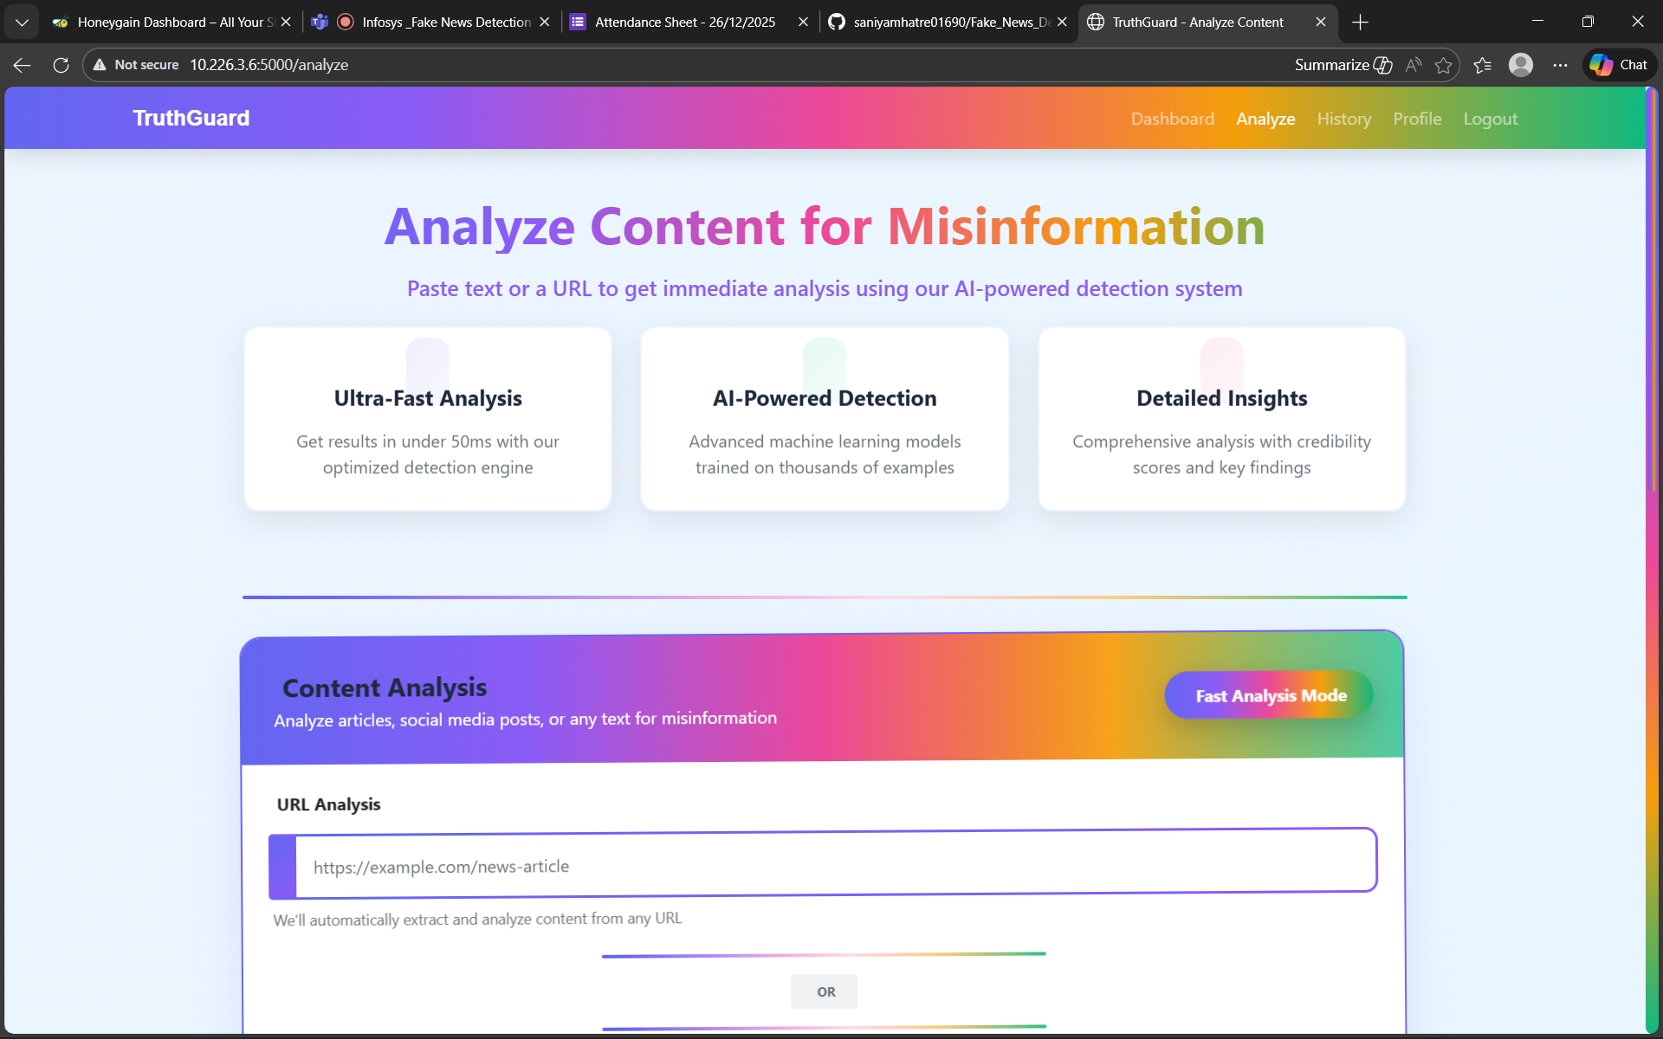
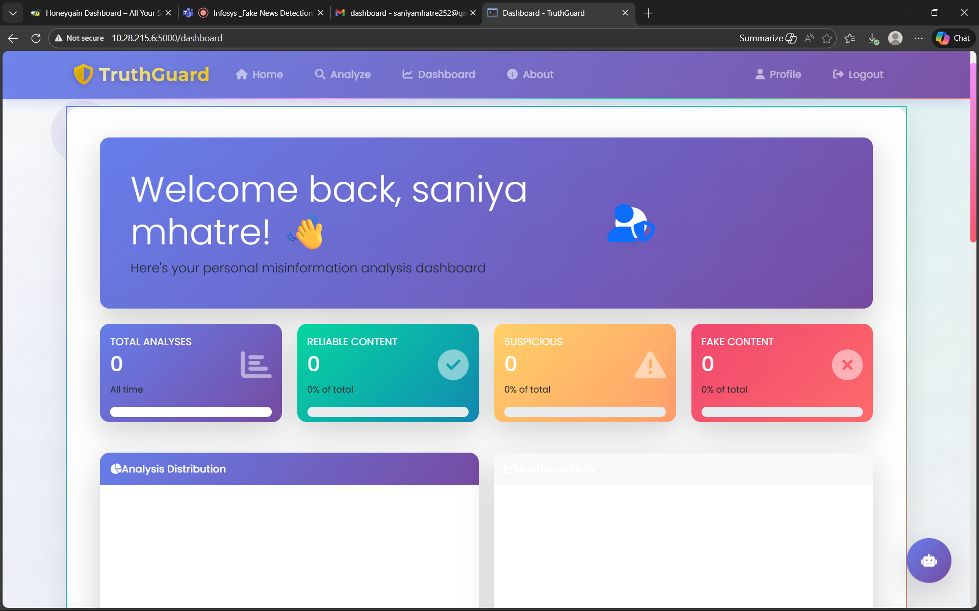
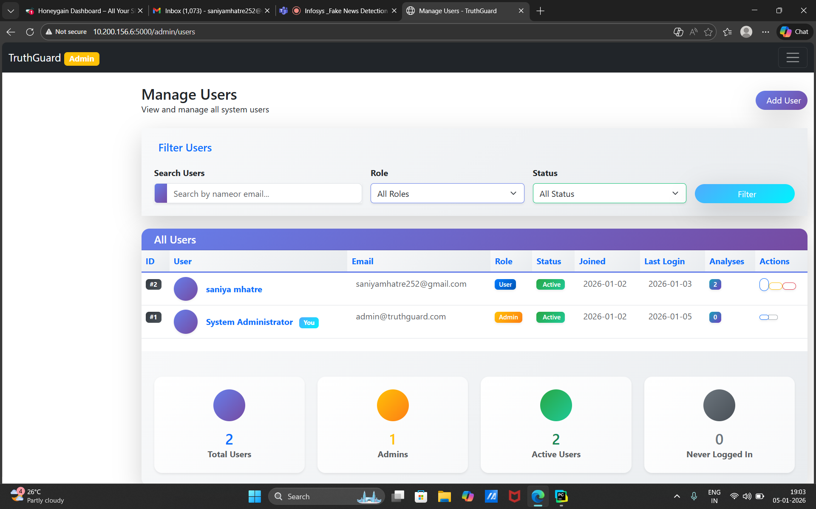
Outcomes:

